Slide 1

CodIng for Christ: The Bean Bar
Created By: Stephanie Otte, Mackenzie Tassiello, Alexis Lona, Aaliyah Balagtas, Sarah Fieck, Reagan Koster, Kaicee and Jonni Kilby, Alona Boyer, and Tiffany Torres
Team 303: Coding for Christ
Notes:
Sarah

Slide 2
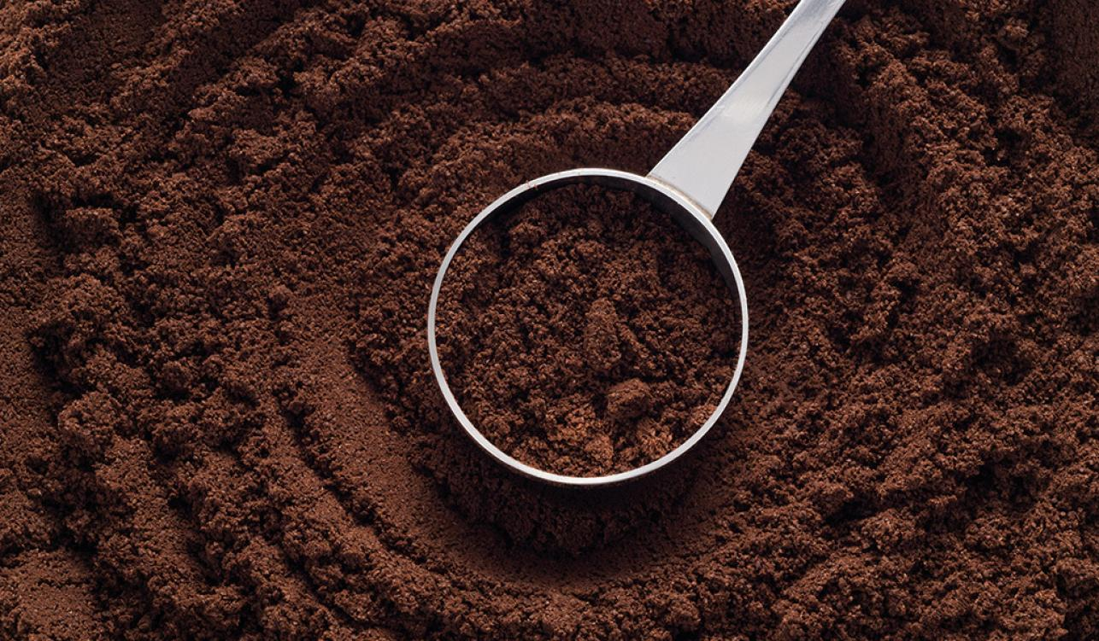
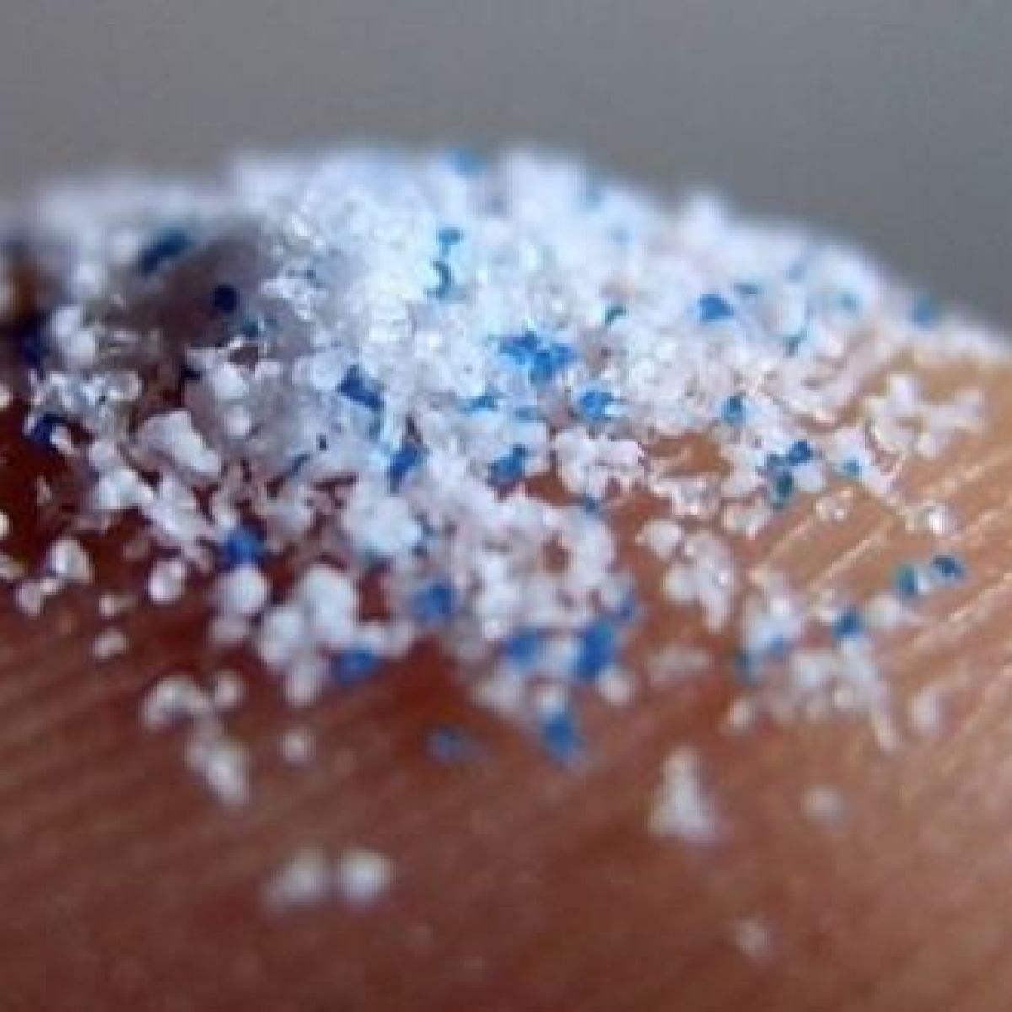
Mission Statement:
We are assisting the ocean ecosystem by reducing microplastic pollution by replacing the microbeads in soap/face washes with coffee grounds.
Notes:
Sarah

Slide 3
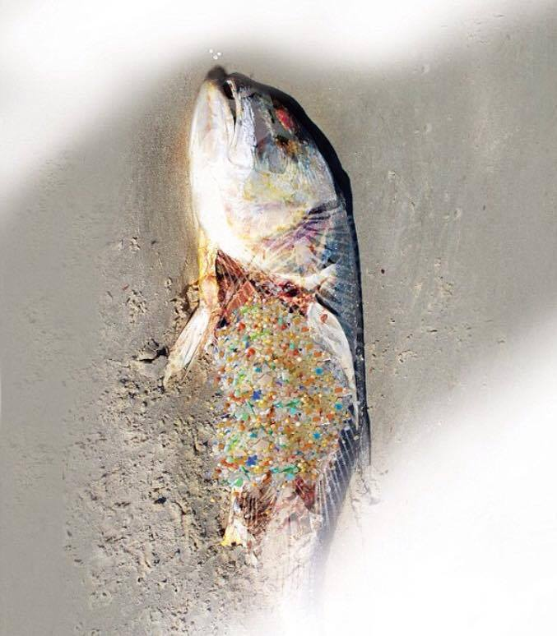
The Problem: How are microbeads polluting our oceans?
The oceans will contain more plastic than fish by 2050 (World Economic Forum)
The average person washes 17,000 bits of plastic down the drain every time they use a face wash with plastic microbeads (Plastic Free Seas)
Microbeads cannot be filtered by most wastewater treatment facilities
An estimated 8 billion microbeads per day are emitted into aquatic habitats in the US, which equals 2.9 trillion per year
Microbeads can be found in your favorite skin products: Neutrogena, Olay, Clean and Clear, etc.
Uses polyethylene as well as polypropylene in their products
Over 1 million marine animals (including mammals, fish, sharks, turtles, and birds) are killed each year due to plastic debris in the ocean
Notes:
MAckenzie

Slide 4
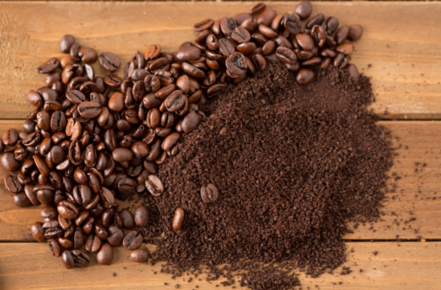
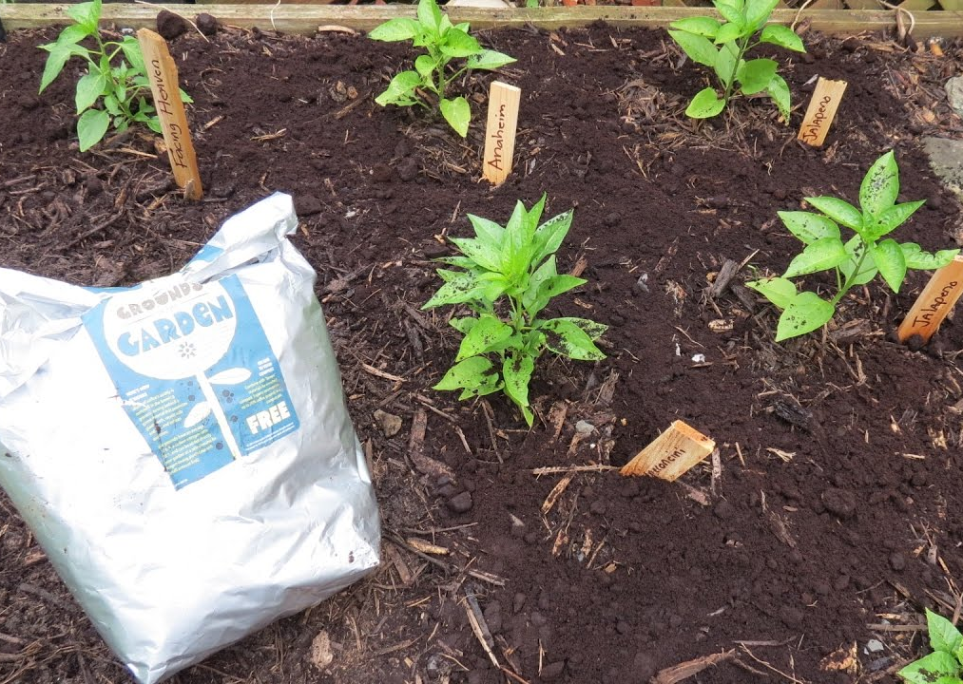
Solution: Coffee grounds!
Discarded coffee grounds can be utilized in soap as a natural exfoliant, replacing microbeads!
An average coffee shop throws out around 22 pounds of coffee grounds a day
This adds up to around 200,000 tons a year
Coffee is biodegradable
Three months to decompose unlike microbeads which never decompose and stays in our oceans
Notes:
Steph

Slide 5
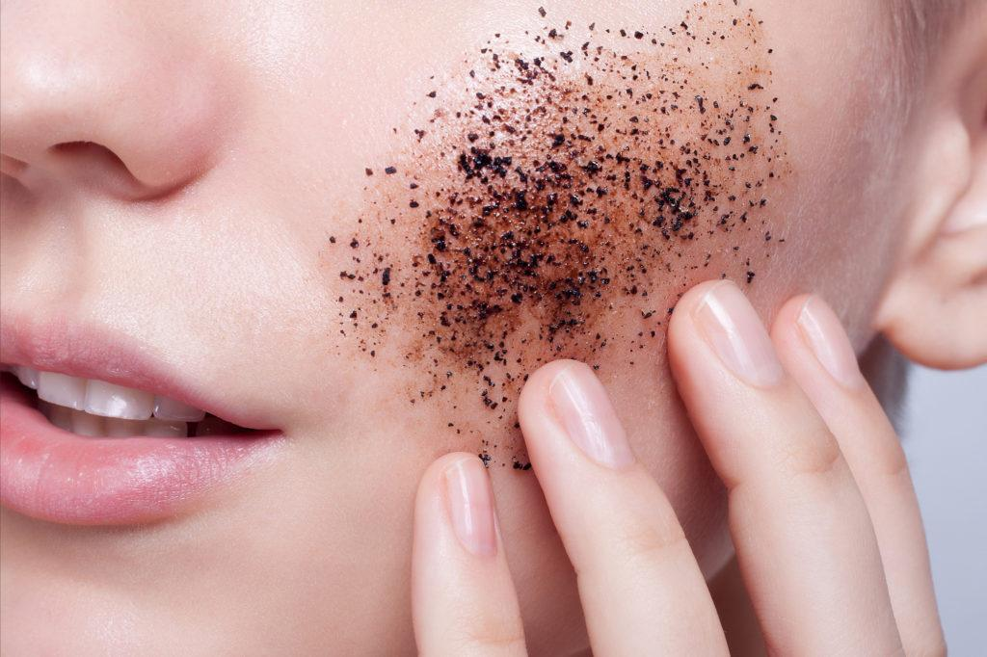
How We Can Make A Difference
Simply change the products you're using at home with this easy to make recipe
By making this product at home
you’re reusing materials (leftover coffee grounds)
Helping the oceans and mammals stay microbead free
Keeping the oceans cleaner one microbead at a time
Coffee face wash recipe:
Mix together 1/2 cup fresh ground coffee and 1/2 cup
brown sugar.
Add 1/2 cup coconut oil into the coffee mixture and 1 tsp. vanilla extract.
Mix until well combined.apply leave on for a couple minutes
Notes:
Steph

Slide 6
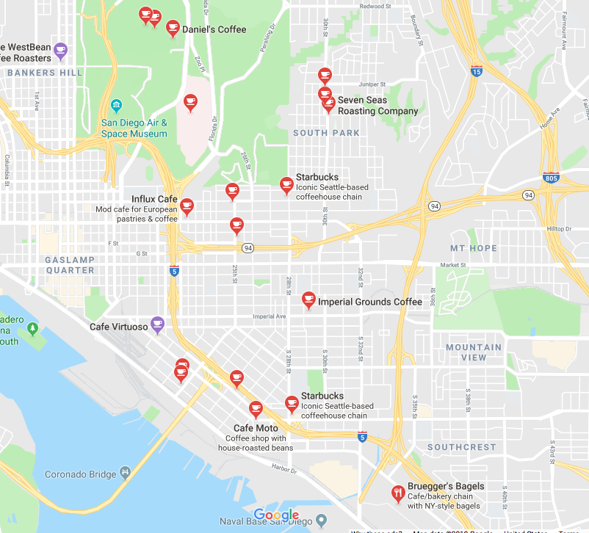
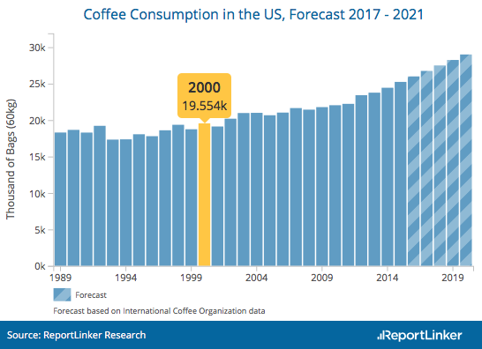
How We USe Data and Maps
GIS; Maps with Spatial Data
Starting with Google Maps
Possible app to connect other smaller restaurants
Tracks where the coffee comes from
Notes:
Alexis

